Slide 1
Introduction to Data science

Slide 2
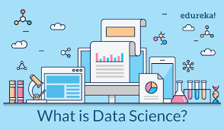
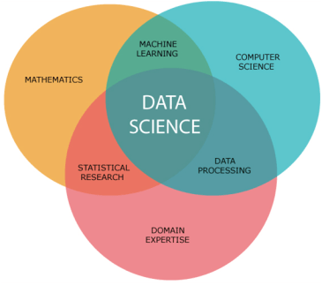
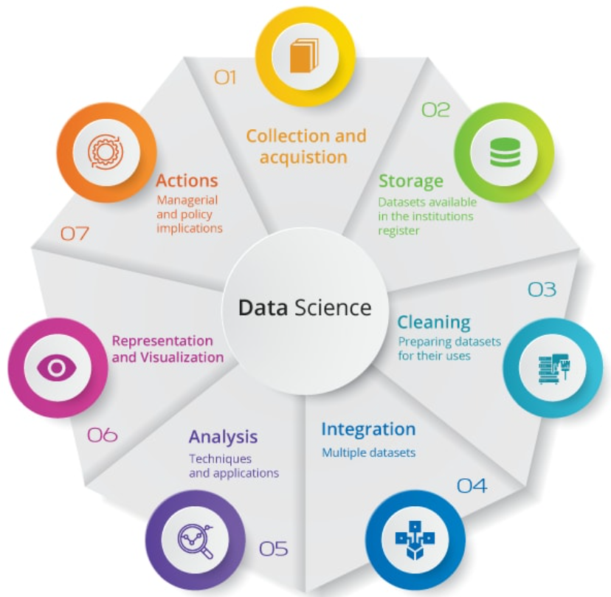
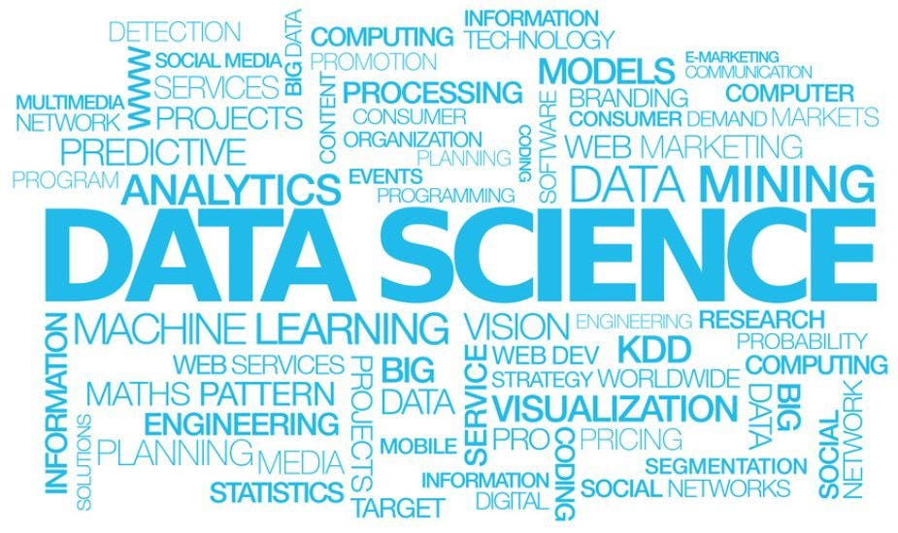
What is data science?

Slide 3
What is data science and what can they do?
Making data work for you - It's a set of methodologies for taking in thousands of forms of data that are available to us today and using them to draw meaningful conclusions.
So what can data do?
Data can describe our current state, like our energy consumption. This can be accomplished with dashboards or alerts, simplifying time-intensive reporting processes.
It can help detect anomalous events, such as fraudulent purchases. If we have data on what has happened previously, we can increase efficiency by automatically detecting a new event that is unexpected or abnormal.
Data can also diagnose the causes of observed events and behaviors, for instance your activity on Spotify or Netflix.

Slide 4
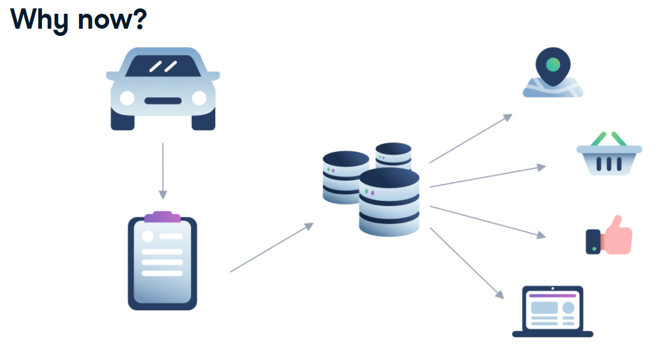
Why now? Why is it so popular?
Sample Scenario - Suppose that you visit a car dealership and fill out some information.
Once we have that data, it's easy to use the email address that you provided when you bought that car to tie your car purchase data with your data from social media or web browsing. Suddenly, we have a very complete picture about everyone who purchased a car in the last year: their ages, their likes and dislikes, their families, their friends. This additional data can be used to predict what price you can pay for your car, and what other purchases you're likely to make, or how best to sell you insurance for that new car.

Slide 5
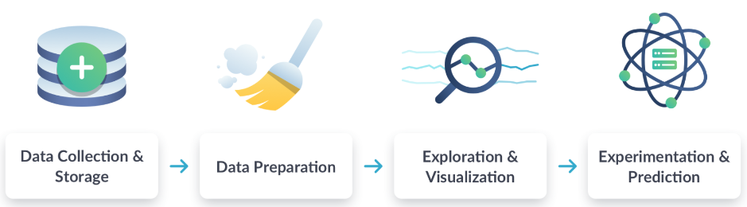
Data Science Workflow
Data Collection and Storage - First, we collect data from many sources, such as surveys, web traffic results, geo-tagged social media posts, and financial transactions. Once collected, we store that data in a safe and accessible way.
Data Preparation – This includes "cleaning data", for instance finding missing or duplicate values, and converting data into a more organized format.
Exploration & Visualization – Then, we explore and visualize the cleaned data. This could involve building dashboards to track how the data changes over time or performing comparisons between two sets of data.
Experimentation & Prediction – Finally, we run experiments and predictions on the data. For example, this could involve building a system that forecasts temperature changes or performing a test to find which web page acquires more customers. Another example is to create a model to predict fraudulent activities.

Slide 6
Let’s Order them
Divide the users into different groups and predict the churn for each group.
Reformat the delivery rate on all entries to be in the same time zone.
Download the data.
Create a line chart that shows decay in subscriptions by group of customers.

Slide 7
Building a customer service chatbot
Data Collection and Storage
Exploration and Visualization
Experiment and Prediction
Gather customer information for each conversation.
Use a machine learning model to predict possible responses for each question.
Create a bar chart of the number of conversations in each type.
Plot the number conversations vs. the time of day.
Load the transcripts into the data teams’ database.
Collect the timestamps for each transcript.
Create an algorithm that classifies the initial customer question.

Slide 8
Examples of Applications of Data Science
Traditional machine learning
Internet of Things (IoT)
Deep Learning

Slide 9
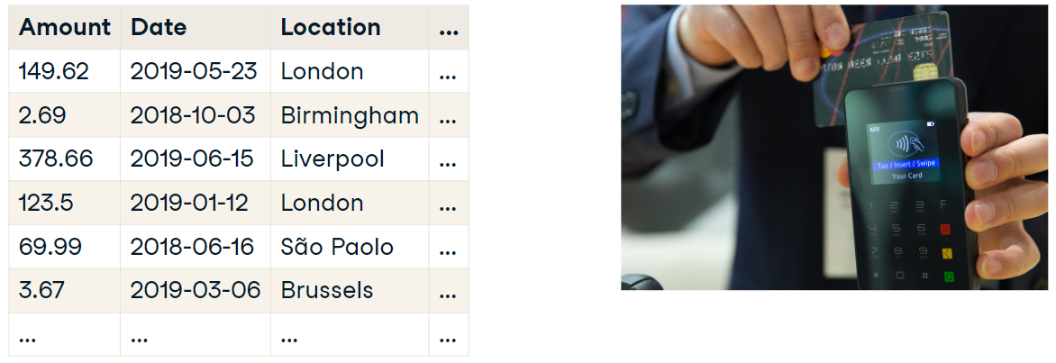
Case study: Fraud Detection
Suppose you work in fraud detection at a large bank. You'd like to use data to determine the probability that the transaction is fake.
To answer this question, you might start by gathering information about each purchase, such as the amount, date, location, purchase type, and card-holder's address. You'll need many examples of transactions, including this information, as well as a label that tells you whether each transaction is valid or fraudulent. Luckily, you probably have this information in a database. These records are called "training data" and are used to build an algorithm (a model). Each time a new transaction occurs, you'll give your algorithm information, like amount and date, and it will answer the original question: What is the probability that this transaction is fraudulent?
What do we need for machine learning?
A well-defined question – What is the probability that this transaction is fraudulent?
A set of example data – Old transactions labeled as fraudulent or valid.
A new set of data to use our algorithm on – New credit card transactions.

Slide 10
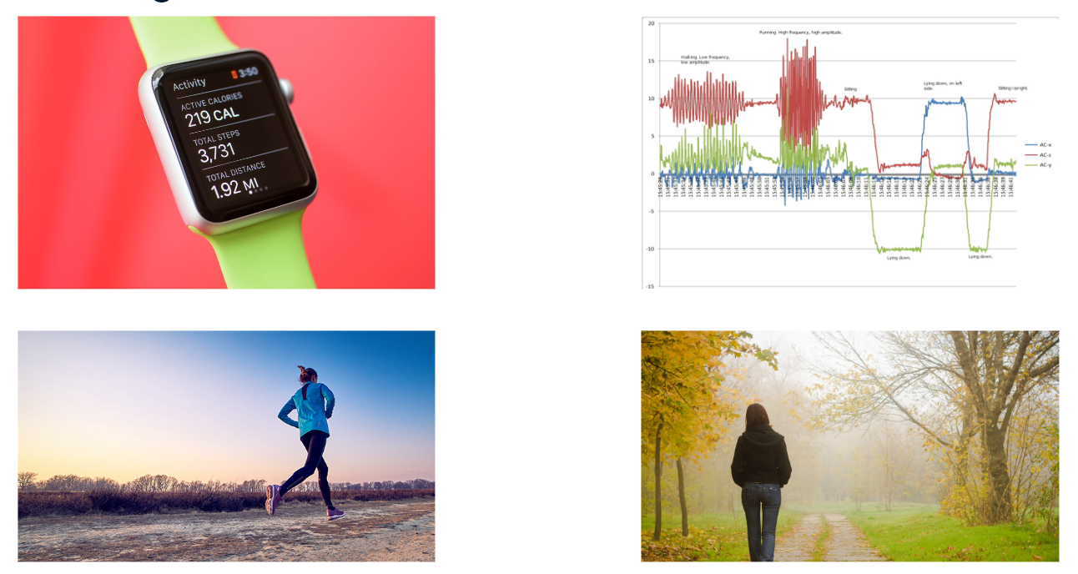
Case Study: Smart Watch
Now, suppose you're trying to build a smart watch to monitor physical activity. You want to be able to auto-detect different activities, such as walking or running. Your smart watch is equipped with a special sensor, called an "accelerometer", that monitors motion in three dimensions. The data generated by this sensor is the basis of your machine learning problem.
You could ask several volunteers to wear your watch and record when they are running or walking. You could then develop an algorithm that recognizes accelerometer data as representing one of those two states: walking or running.
Your smart watch is part of a fast-growing field called "the Internet of Things", also known as IoT, which is often combined with Data Science.
IoT refers to gadgets that are not standard computers, but still can transmit data. This includes
smart watches,
internet-connected home security systems,
electronic toll collection systems,
building energy management systems, and much, much more.
IoT data is a great resource for data science projects!

Slide 11
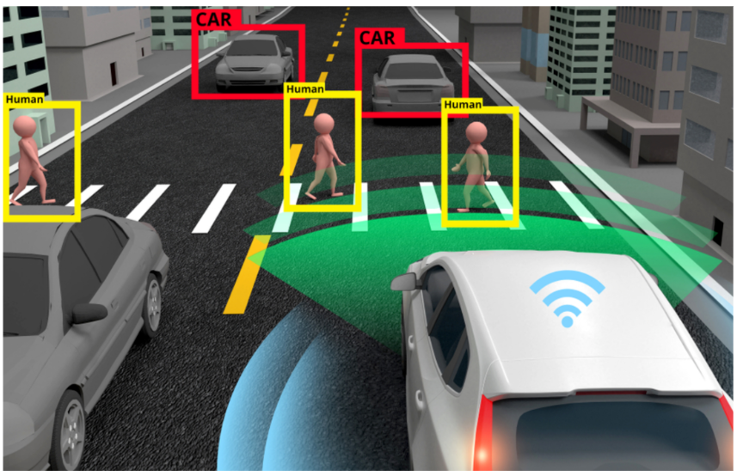
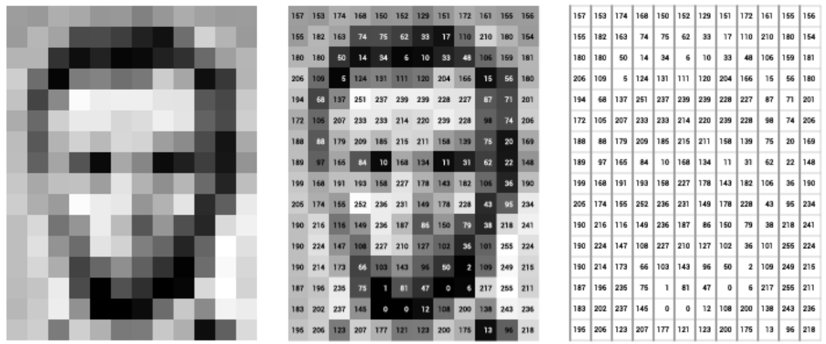
Case Study: Image Recognition
We could express the picture as a matrix of numbers where each number represents a pixel. However, this approach would probably fail if we fed the matrix into a traditional machine learning model. There's simply too much input data!
We need more advanced algorithms from a subfield of machine learning called deep learning. In deep learning, multiple layers of mini-algorithms, called "neurons", work together to draw complex conclusions. Deep learning takes much, much more training data than a traditional machine learning model, but is also able to learn relationships that traditional models cannot. Deep learning is used to solve data-intensive problems, such as image classification or language understanding.
Deep Learning
Many neurons work together
Requires much more training data.
Used in complex problems
Image Classification
Language Learning/Understanding

Slide 12
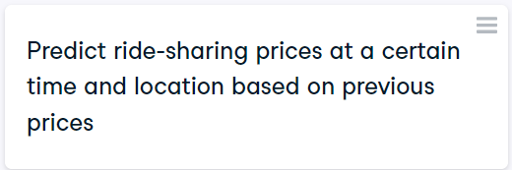
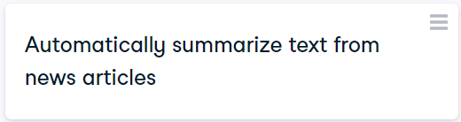
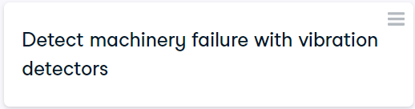
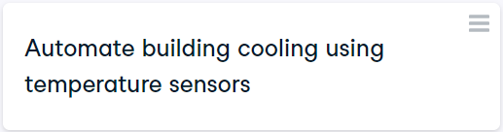
Exercise
Laura manages an analytics team and has a few tasks that she's hoping to achieve this quarter. The tasks are centered around the following domains:
traditional machine learning
deep learning
Internet of Things (IoT)
The knowledge to build traditional machine learning and deep learning applications is present within her team. There is another team in the company that is specialized in working with IoT data. Laura wants to know for which tasks she'll need their help.
Traditional Machine Learning
Internet of Things
Deep Learning

Slide 13
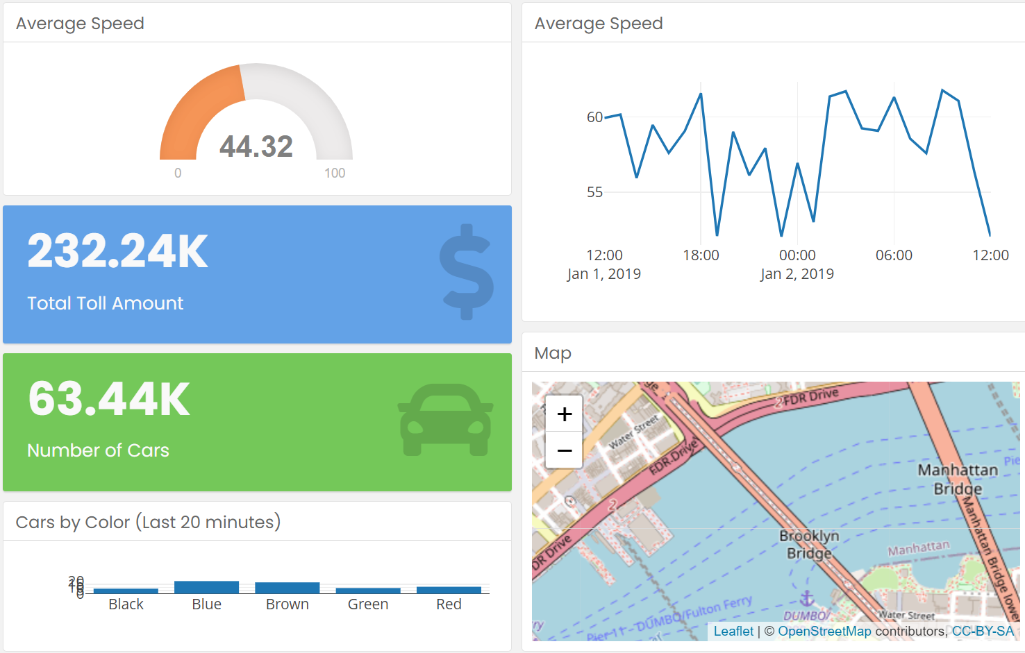
Exercise
Investment research
Greg is an investment analyst. He's been asked to review a new start-up that uses easy-to-install vibration sensors to measure the amount of traffic on a bridge or highway. His boss has asked him to do some background research and decide which category this start-up belongs in.
Take a look at the startup's dashboard and help Greg answer this question. Some of the plots in the dashboard are interactive and may change as you interact with them. You can always reset any plot to its original state by double-clicking it.
Which category best fits this start-up?
Traditional machine learning
Deep learning
Internet of Things
Natural language processing

Slide 14
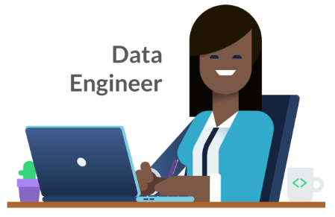



Roles in Data Science
Data Engineer
Data Analyst
Data Scientist
Machine Learning Scientist/Engineer

Slide 15
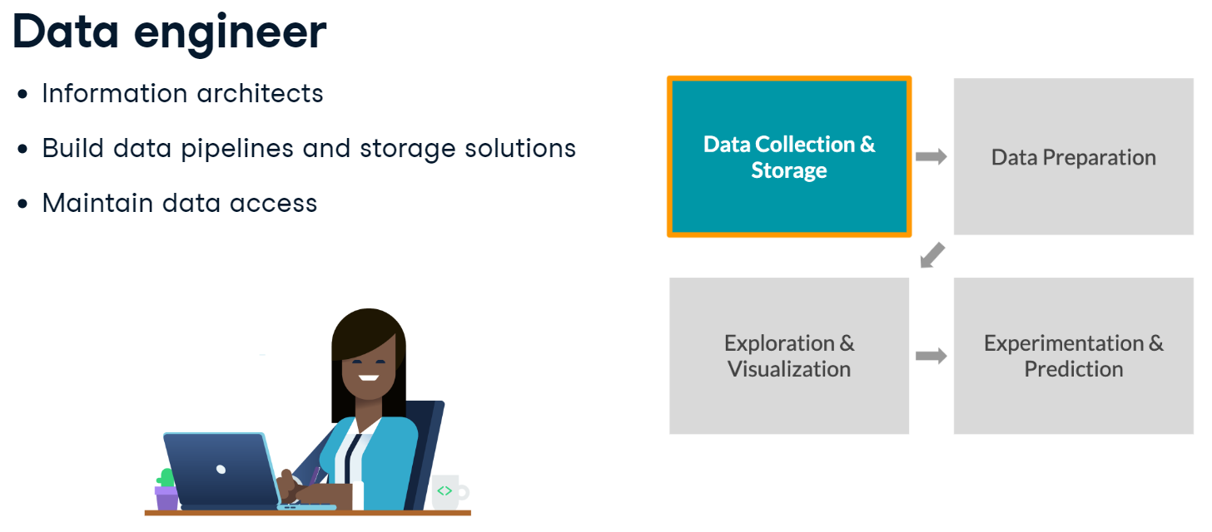
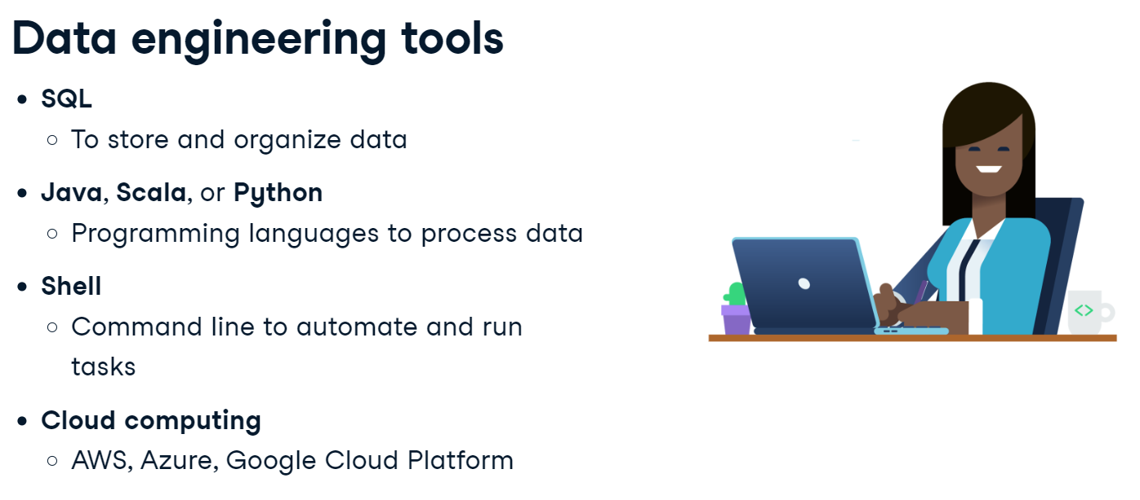
Data Engineer
Data engineers control the flow of data: they build custom data pipelines and storage systems. They design infrastructure so that data is not only collected, but easy to obtain and process. Within the data science workflow, they focus on the first stage: data collection and storage.

Slide 16
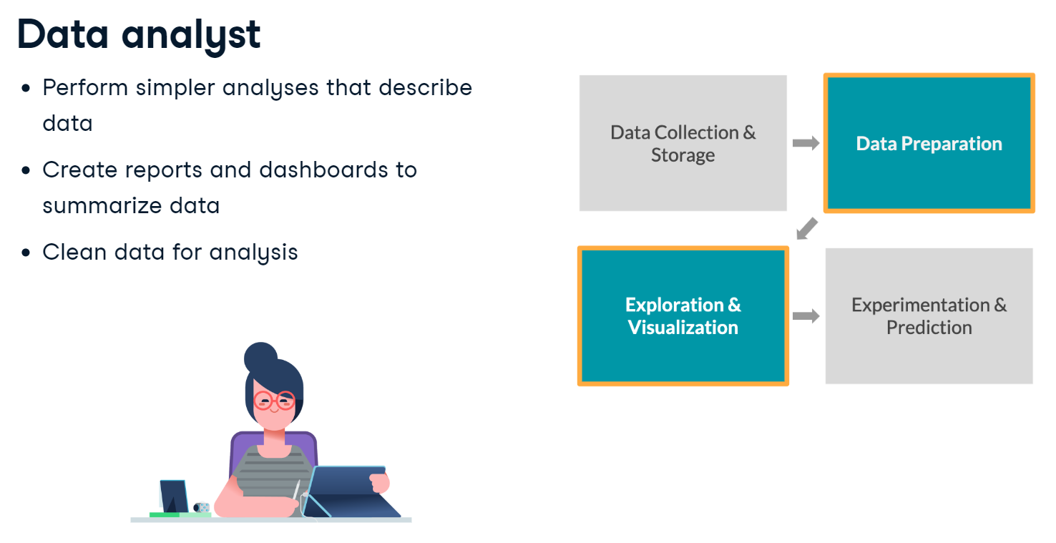
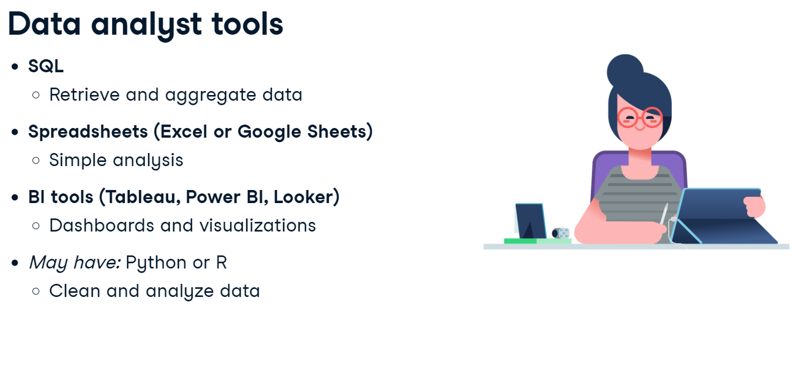
Data Analyst
Data analysts describe the present via data. They do this by exploring the data and creating visualizations and dashboards. To do these tasks, they often have to clean data first. Analysts have less programming and stats experience than the other roles. Within the workflow, they focus on the middle two stages: data preparation and exploration and visualization.

Slide 17
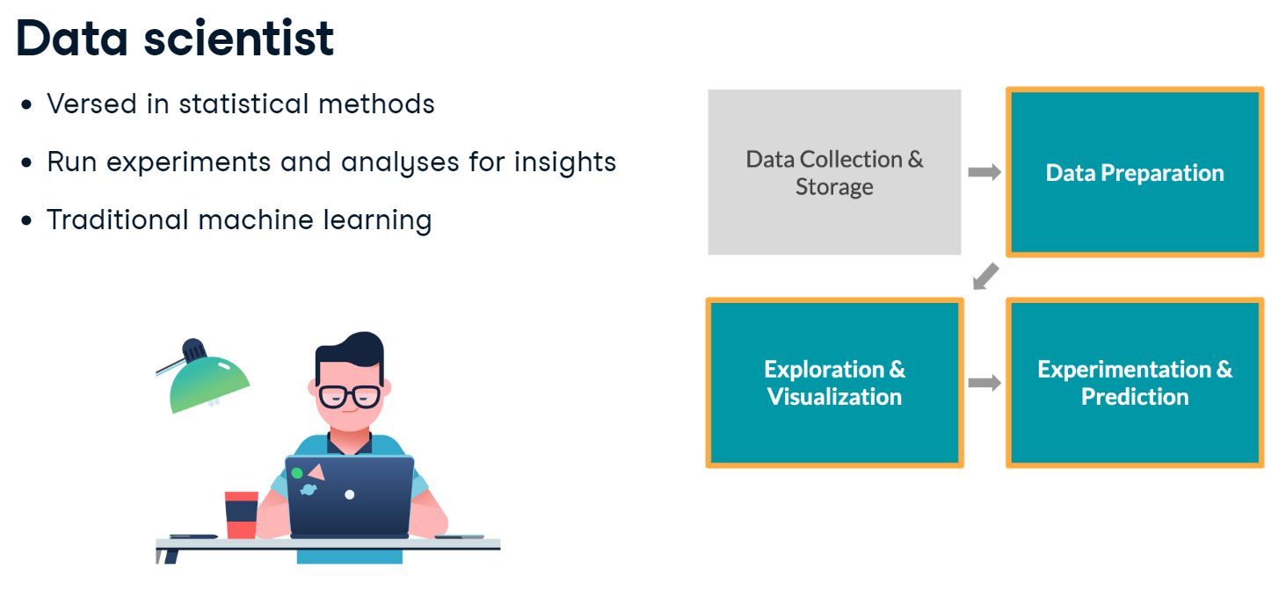
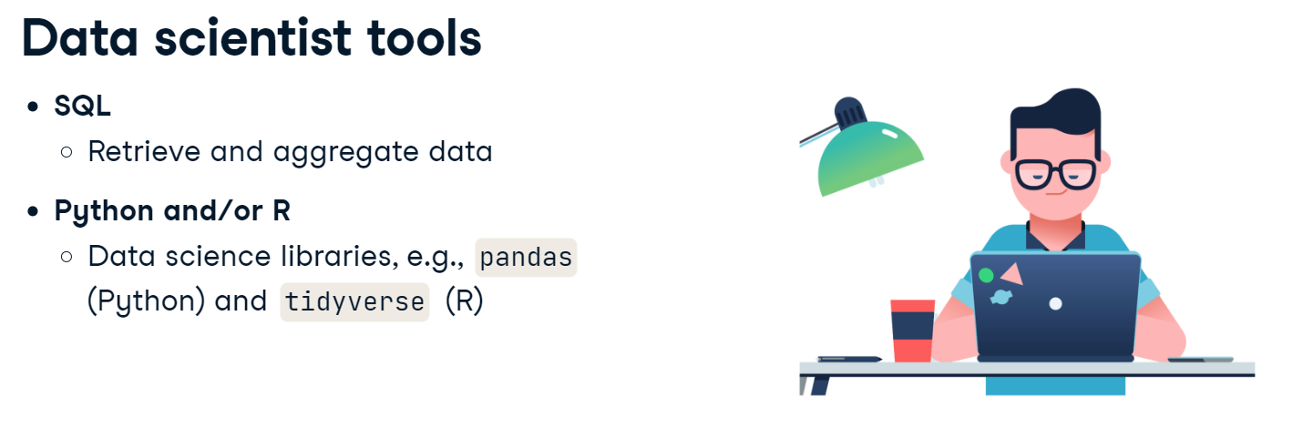
Data Scientist
Data Scientists have a strong background in statistics, enabling them to find new insights from data, rather than solely describing data. They also use traditional machine learning for prediction and forecasting. Within the workflow, they focus on the last three stages: data preparation and exploration and visualization, and experimentation and prediction.

Slide 18
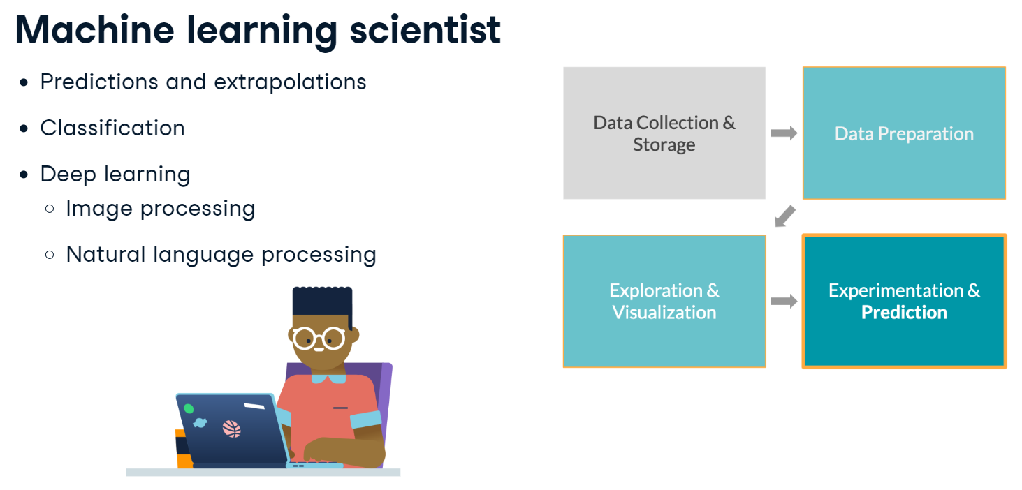

Machine Learning Scientist
Machine learning scientists are similar to data scientists, but with a machine learning specialization. Machine learning is perhaps the buzziest part of Data Science; it's used to extrapolate what's likely to be true from what we already know. These scientists use training data to classify larger, unrulier data, whether its to classify images that contain a car, or create a chatbot. They go beyond traditional machine learning with deep learning. Within the workflow, they do the last three stages with a strong focus on prediction.

Slide 19
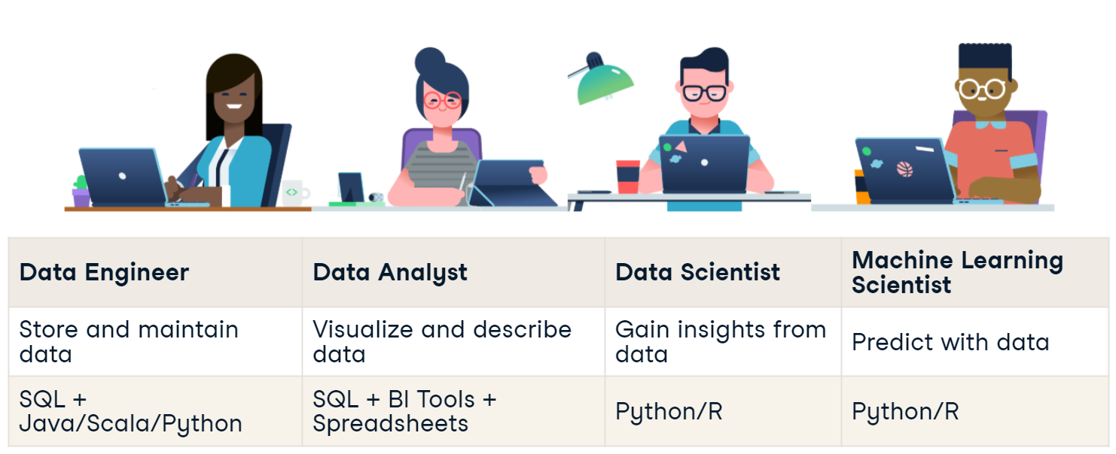
Matching skills to jobs
Johan manages a Data Science team and is looking to post some new job listings for a Data Engineer and a Machine Learning Scientist. Help Johan decide which skill requirements belong with each job.
Data Engineer
Data Analyst
Data Scientist
Give new team members data base access
Update Excel spreadsheet with new graphs
Train an anomaly detection algorithm
Run a correlation analysis between weather and ice cream sales
Create a dashboard for the marketing team
Create a new table in the SQL database

Slide 20
Matching skills to jobs
Johan manages a Data Science team and is looking to post some new job listings for a Data Engineer and a Machine Learning Scientist. Help Johan decide which skill requirements belong with each job.
Data Engineer
Data Scientist
Expert at building and maintaining SQL databases
Some higher education in statistics
Proficient in using Python for prediction and modeling
Strong Java skills
Experience in using TensorFlow for implementing deep learning architecture

Slide 21
Data Collection

Slide 22
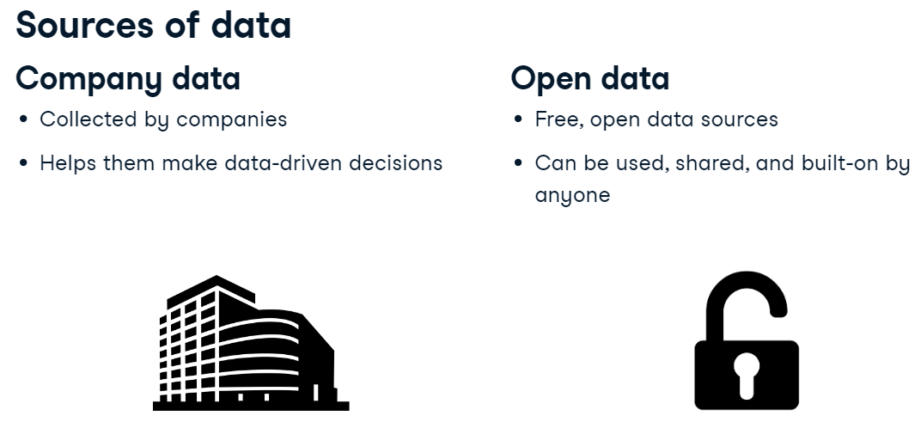
Data sources

Slide 23
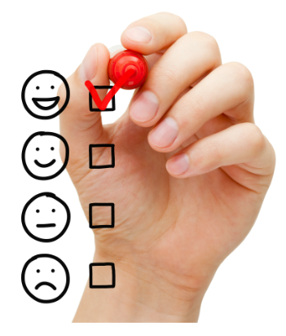
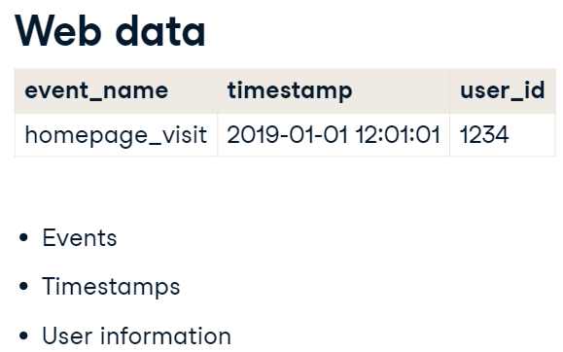
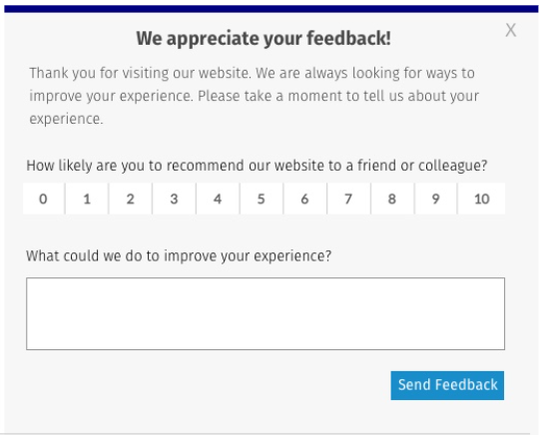
Company data
Some of the most common company sources of data are web events, survey data, customer data, logistics data, and financial transactions.
Web Data - When you visit a web page or click on a link, usually this information is tracked by companies in order to calculate conversion rates or monitor the popularity of different pieces of content. The following information is captured: the name of the event, which could mean the URL of the page visited or an identifier for the element that was clicked, the timestamp of the event, and an identifier for the user that performed the action.
Survey Data - Data can also be collected by asking people for their opinions in surveys. This can be, for example, in the form of a face-to-face interview, online questionnaire, or a focus group.

Slide 24
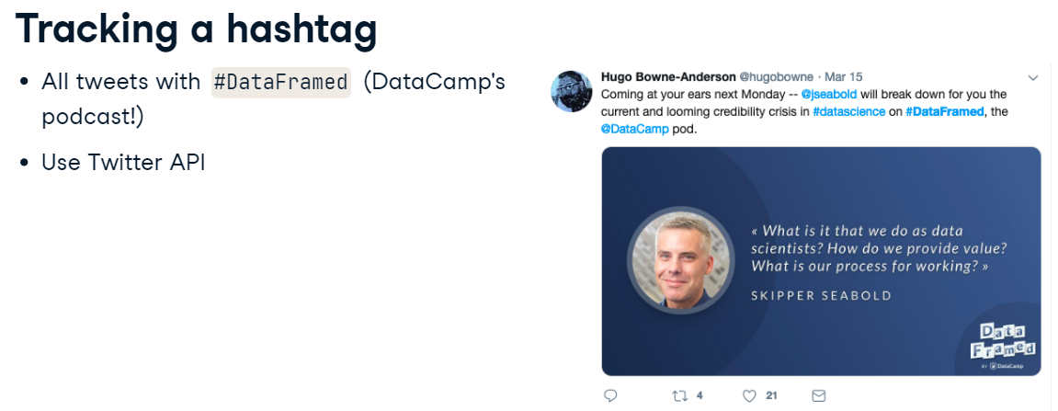
OPEN DATA
There are multiple ways to access open data. Two of them are APIs and public records.
Public data APIs - API stands for Application Programming Interface. It's an easy way of requesting data from a third party over the internet.
Many companies have public APIs to let anyone access their data. Some notable APIs include Twitter, Wikipedia, Yahoo! Finance, and Google Maps, but there are many, many more.
Sentimental analysis
See if positive tweets are correlated with more downloads?

Slide 25


OPEN DATA
Public records are another great way of gathering data. They can be collected and shared by international organizations like
the World Bank, the UN, or the WTO, national statistical offices, who use census and survey data, or
Government agencies, who make information about for example the weather, environment or population publicly available.
For example, in the US, data.gov has health, education, and commerce data available for free download. In the EU, data.Europa.eu has similar data.

Slide 26
Exercise
Company Data
Open Data
Average household income in Miami-Dade County
Stock prices of different beauty brands over time
Number of people clicking on the Coming Soon link on a company website.
The number of customers that bought an iPhone in Bangkok in December last year
Number of women between the ages of 30 – 45 living in Orange County
How likely an Airbnb user is to recommend the website to a friend or colleague

Slide 27
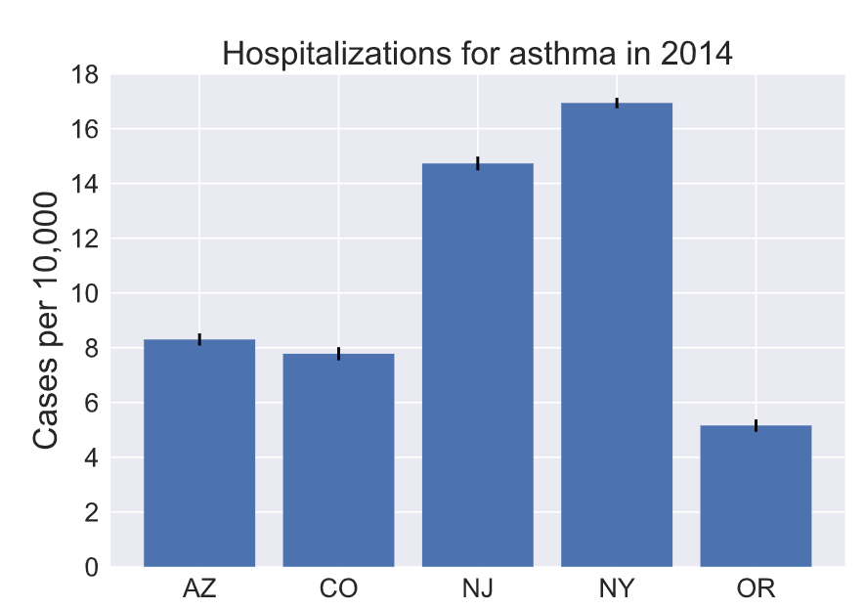
Exercise
Asthma frequencies
You've realized by now that data can come from various sources, and not all of them are publicly available. A data science report contains the following visualization. With your new knowledge of data sources, you are able to identify where the data that's behind it originated.
What source has the data scientist most likely used to collect this data?
APIs
Public records
Web events

Slide 28
Data Types
Why care about data types?
Important when
Storing the data
Visualizing/analyzing the data

Slide 29
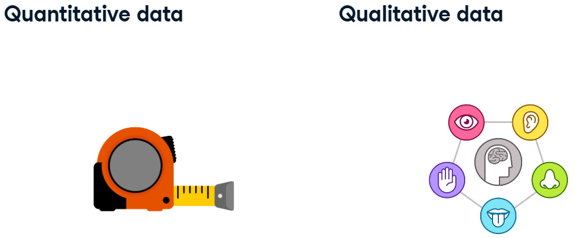
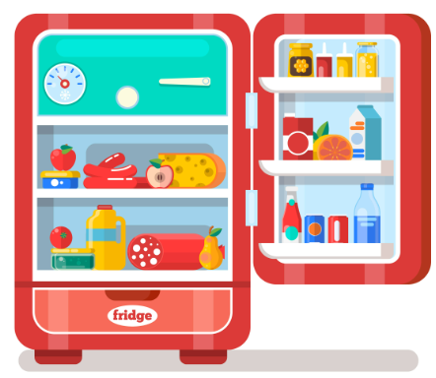
Quantitative vs. Qualitative Data
There are two general types of data: qualitative and quantitative data. It’s important to understand the key differences between both.
Quantitative data can be counted, measured, and expressed using numbers. Qualitative data is descriptive and conceptual.
Qualitative data can be observed but not measured.
For example, quantitative data can be expressed in numbers. For example, the fridge is 60 inches tall, has two apples in it, and costs 1000 dollars. Qualitative data, on the other hand, are things that can be observed but not measured like the fridge is red, was built in Italy, and might need to be cleaned out because it smells like fish.

Slide 30
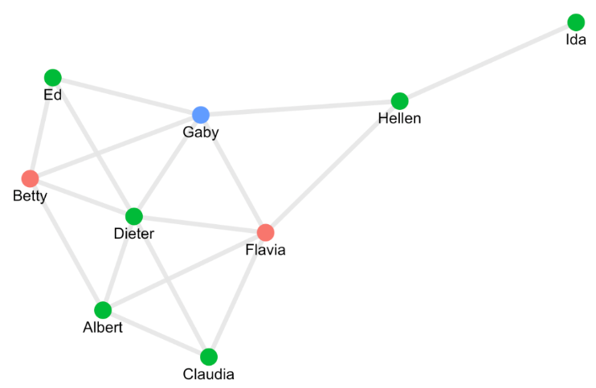
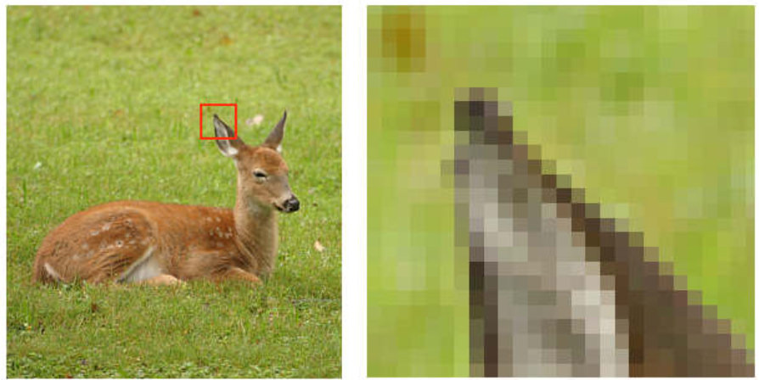
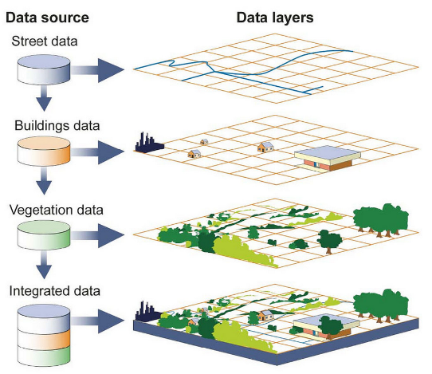
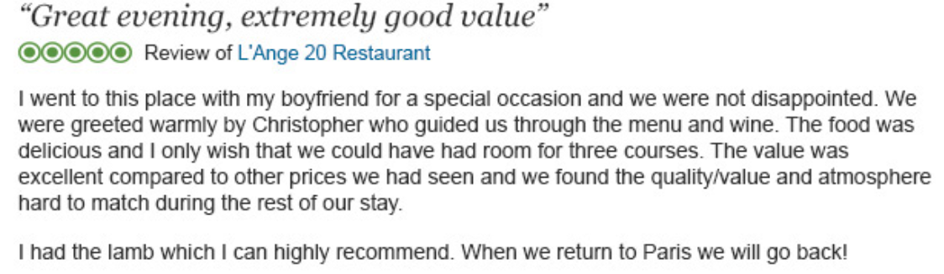
Other data Types?
Other than the traditional quantitative and qualitative data, there are many other data types that are becoming more and more important.
Image data
Text data
Geospatial data – data with location information
Network data – e.g., Social network
and many more

Slide 31
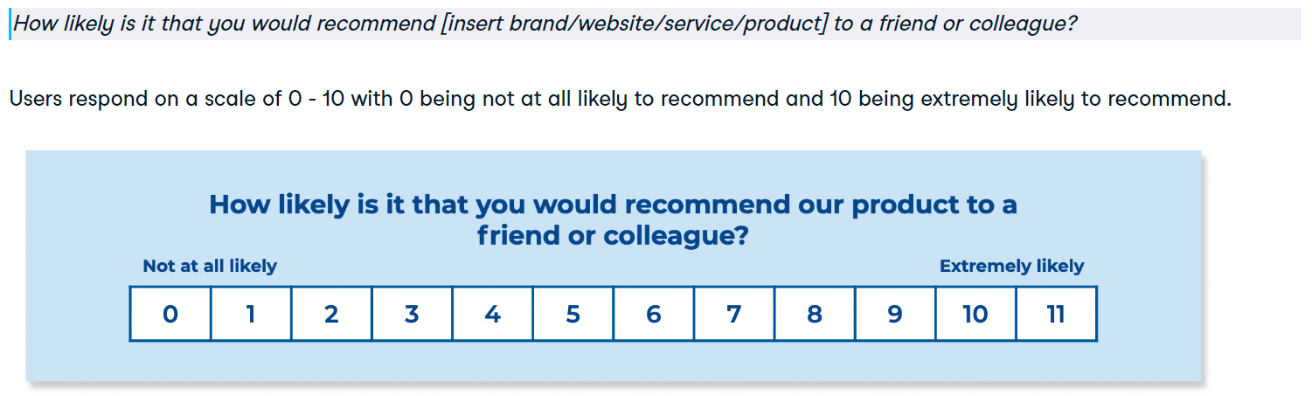
Exercise – Classifying data types
Quantitative Data
Qualitative Data
The reviews for a property on Airbnb
The price of a cup of coffee in StarLord Coffee
The maximum speed of formula one cars during 2022 season
The individual weight of all students in the class
The daily average temperature in Bangkok during summer this year
Images of several cats
The eye color of people participating in a study
The gender of students in Data Science fields

Slide 32
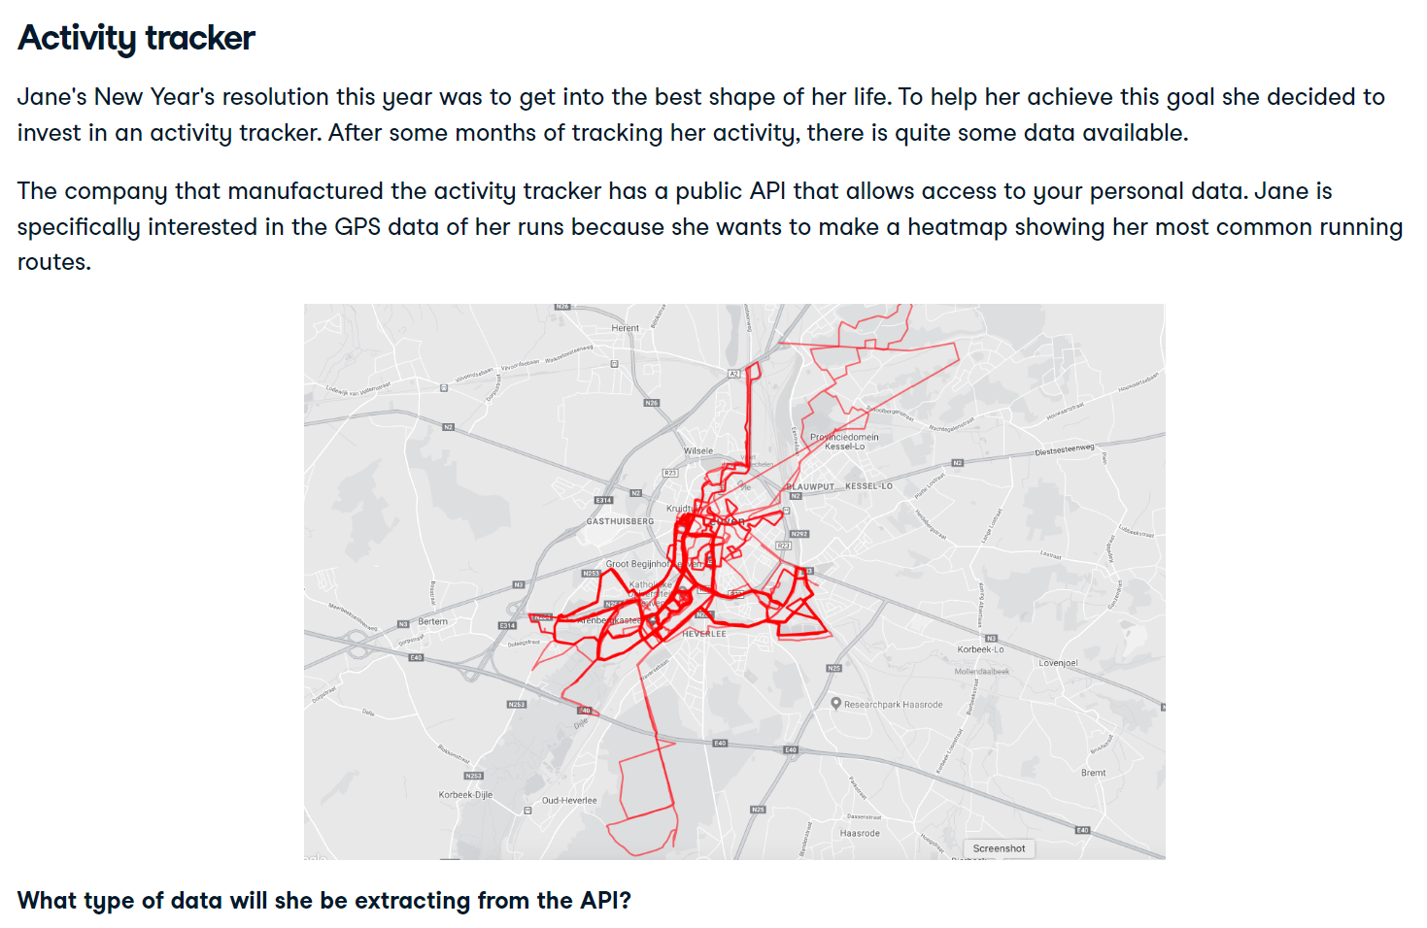
Which one?
Image data
Text data
Geospatial data
Network data

Slide 33
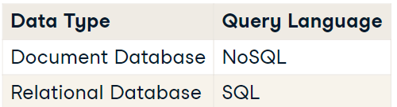
Data Storage and Retrieval
When storing data there are multiple things to take into consideration.
Data storage location – single PC, a cluster of servers, cloud storage.
Data type
Unstructured – Email, text, video and audio files, web pages, social media, etc. typically stored in Document database
Structured – Relational database such as MySQL, PostgreSQL
Retrieval
At a basic level, we’ll want to be able to request a specific piece of data, such as “All of the images that were created on March 3rd” or “All of the customer addresses in Montana”.
NoSQL, SQL

Slide 34
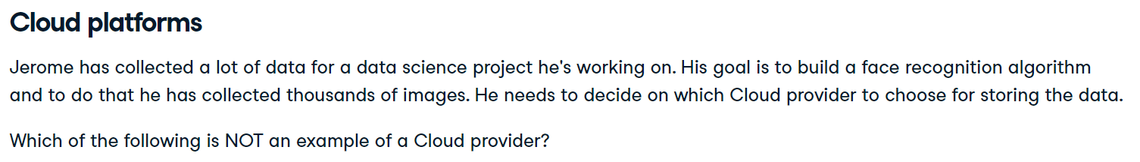
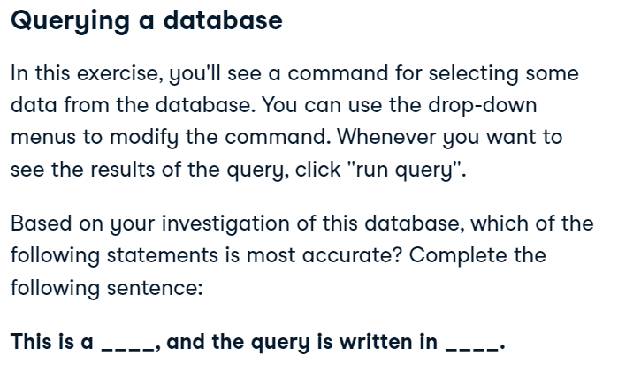
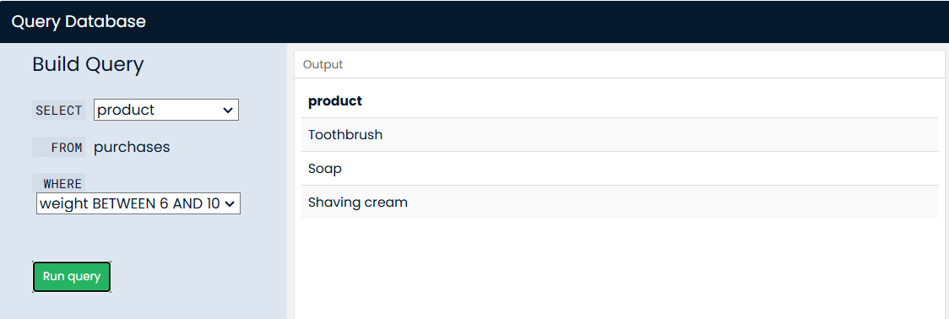
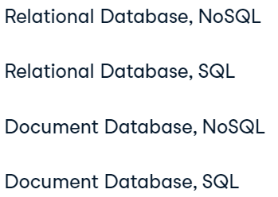
(1) Google Cloud (2) Oracle Database (3) AWS S3 (4) Azure Storage (5) Tencent Cloud (6) IBM SQL Server

Slide 35
Relational Database
Document Database
Text from various emails sent and received by you.
The dates, times, subjects and recipient addresses for all emails you ever sent.
Customer information for all students of VMS such as name, phone number and location.
Images of different traffic events, including metadata about the image’s contents.

Slide 36
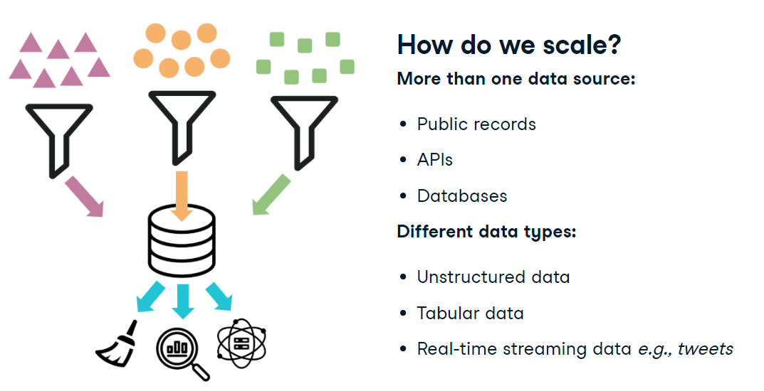
How do we scale data collection – Data Pipelines

Slide 37
What is data pipeline?
Moves data into defined stages – for example, from data ingestion through an API to loading data into a database. A key feature is that pipelines automate this movement.
Automated collection and storage - it would be tedious to ask a data engineer to manually run programs to collect and store data.
Scheduled hourly, daily, weekly, etc.
Triggered by an event
Monitored with generated alerted – for example, when 95% of storage capacity has been reach or if an API is responding with an error.
Necessary for big data projects – when working with a lot of data from different sources.
Data engineers work to customize solutions.
Extract Transform Load (ETL)

Slide 38
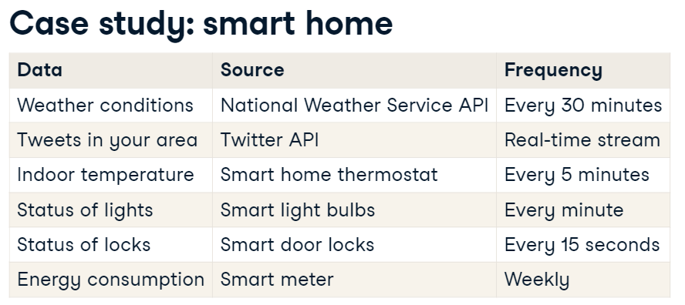
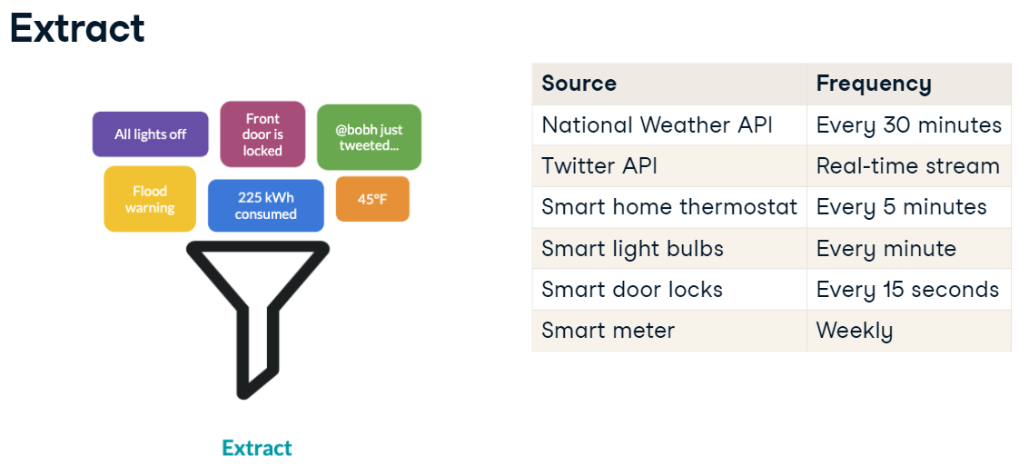
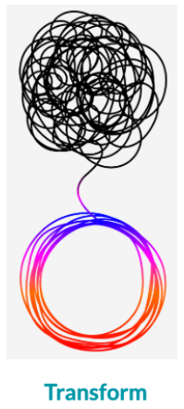
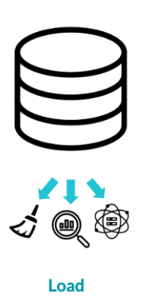

Slide 39
Data Pipelines – transform & LOAD
With all the data coming in, how de we keep it organized and easy to use? Example transformations:
Joining data sources into one data set.
Converting data structures to fit database schemas.
Removing irrelevant data - For example, the Twitter API, not only gives you a tweet but other details, like the number of followers the author has, which is not useful in this scenario.
Note: Data preparation and exploration does not occur at this stage.
Finally, we load the data into storage so that it can be used for visualization and analysis.
Once we've set up all those steps, we automate. For example, we can say every time we get a tweet, we transform it in a certain way and store it in a specific table in our database.

Slide 40
Data pipeline characteristics
Which of the following statements is true?
A data pipeline is essential for every data science project.
In the transform phase of ETL, data analysts perform exploratory data analysis.
Data engineers design and build custom data pipelines for projects.
Data pipelines do not require automation.

Slide 41
Extract
Transform
Load
Use the Apple Store API to get the latest download and rating information.
Combine data on different users into one data set for all users.
Collect the latest songs listened to by users on the mobile app.
Group and arrange user listening data by musician.
Store listening data into a database used by machine learning scientists to generate personalized playlists.

Slide 42
Data Preparation

Slide 43
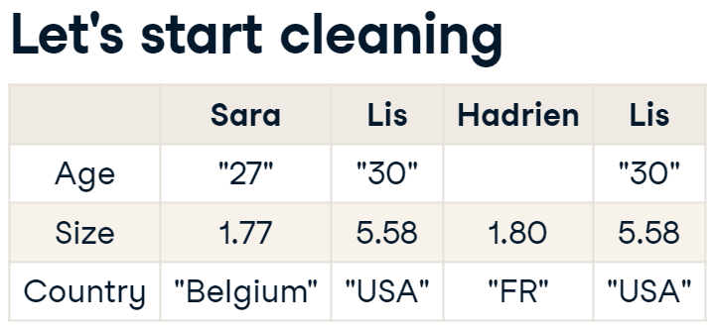
Why prepare data?
Real-life data is messy. Data rarely comes in ready for analysis.
Data preparation is done to prevent:
errors,
incorrect results,
biasing algorithms.

Slide 44
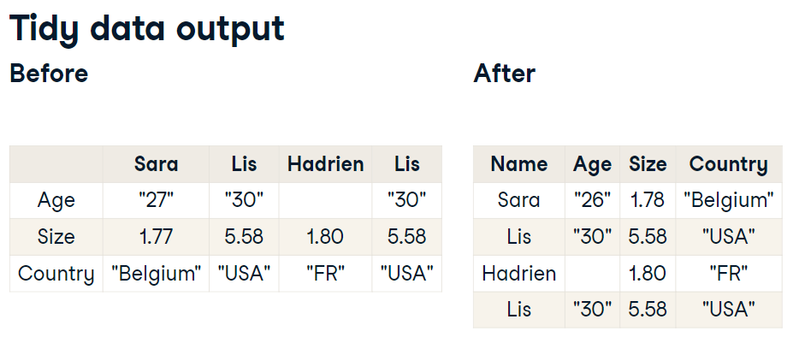


Keys
Tidiness
Remove duplicates
Unique ID

Slide 45




Keys
Homogeneity
Different units used in different countries
Abbreviations
Data types
str, int
Missing values

Slide 46

Last night, you were stargazing with a friend, and you saw something strange in the sky. You decide to look into UFO (Unidentified Flying Object) reports to see if anyone has seen something similar in your area. Luckily, you find a UFO reports dataset, but before analyzing it, you need to prepare the data! Here is a snapshot of the first 5 rows.

Slide 47


Slide 48







Slide 49
Exploratory data analysis (eda)

Slide 50

What is eda?
It consists of
exploring the data and
formulating hypotheses about it, and
assessing its main characteristics, with a strong emphasis on visualization.

Slide 51

All for data sets display:
Identical mean and variance for x
Identical mean and variance for y
Identical correlation coefficient
Identical linear regression equation
In short: they look quite similar
Note: Data till 3rd month of 2018

Slide 52


Slide 53


Another example – SpaceX launches
Knowing your data
Previewing your data

Slide 54




Slide 55

Outliners
Another thing you do during EDA is look for outliers, that is, unusual values. Whether they are errors or valid, it's nice to know about them, as they can throw your results off. Here, we can see we have only 5 launches with a weight greater than 7,000 kg, when the average mass is closer 3800 kg.

Slide 56

A few years ago, KIC 8462852, also known as Tabby's star, started decreasing strongly in luminosity. We're not sure why yet, but scientists are investigating by recording observations at different times and locations.
Below are some descriptive statistics on the observations. Unlike the qualitative dataset we saw in the video, the Tabby's star dataset is made of quantitative data only, so we get statistics, like the mean and median.
How many separate luminosity observations make up the dataset?

Slide 57

Visual EDA
Your friend graphed the star's luminosity using data he copied from public sources. He shows you the graph below. He concludes that scientists have it completely backwards. Scientists say the star is dimming, as the graph shows the luminosity is actually pretty flat, except one moment when it increases a lot.
Which of the following statements is true?
1. The data and graph has to be correct. As the graph shows, the star must have been stable, except for a brief luminous spike in mid-2012. Scientists should focus on what made that star spike in luminosity.
2. Something weird is going on. That jump here is an outlier and the data should be reviewed.
3. If scientists and journalists say the star is dimming, then the star is dimming. It does not matter that the data states otherwise.

Slide 58

All values are centered around 1, except one occurrence at 9.8748. Turns out the correct value is 0.98748. Your friend misplaced the period when copying the values. After correcting, the graph looks much better, and the star is indeed dimming.

Slide 59




Visualization tips
Use color purposefully
Colorblindness
Readable fonts
Label, Label, Label
Title, x-Axis, y-Axis
Easy-to-understand charts

Slide 60


Dashboards

Slide 61



Which suggestion would you not give?
1. The bars in the "Cars by Color" graph should match the car colors they represent.
2. MPH (miles per hours) should be added to the title and axis labels referring to average speed.
3.The "Total Toll Amount" and "Number of Cars" components need a date associated with them.
4. The y-axis in the top right "Average Speed" graph needs to start at 0, as opposed to 52.

Slide 62

Experimental and prediction

Slide 63

What are experiments in data science
Experiments help drive decisions and draw conclusions.
Form a question
Form a hypothesis
Collect data
Test the hypothesis with statistical test
Interpret results

Slide 64




Slide 65




Time series forecasting
Modeling in DS
Represent a real-world process with statistics
Mathematical relationships between variables, including random variables.
Based on statistical assumptions and historical data
Ranges in complexity, from linear equation to a deep learning algorithm.

Slide 66

Time series data
A series of data points sequenced by time.
Stock prices
Gas prices
Unemployment rates
Heart rate
Inflation rate
CO2 levels
World temperature
Height of ocean tides
Fuel consumption during winter
Forecasting time series
How much rainfall will we get next month?
Will traffic ease up in the next half hour?
How will the stock market move in the next six hours?
What will be earth’s population in 20 years?
What will be % of EV cars in 5 years?
Derive a model from historical data to generate predictions.
Modeling methods use a combination of statistical and machine learning methods.

Slide 67


There are also two blue areas shown along the forecast. These are confidence intervals, which are extremely useful for evaluating predictions. We see two confidence intervals: 80% and 95%. The model is 80% sure that the true value will be in the area labeled as 80. Same goes with the area labeled as 95. If we're using this forecast to make big decisions, confidence intervals can help us buffer for the unexpected.

Slide 68
Which one is and is not Time series data?
The price of an airline ticket during different seasons.
Weekly energy consumption.
Name and address of users.
Number of steps walked every day for the past year.
Geo-spatial of all hiking-trial in Yosemite park.
Food nutrients in Thai cuisine.
VMS intakes and retention rate for the last 5 years.
Engine RPM of different car models.

Slide 69

Interpret a time series plot
Below is a forecast of potato prices in Rwanda for the years 2016 and 2017.
Which of the following statements is true about the model's prediction?
The model is 95% confident that the highest the price will peak is 410 Rwandan francs.
The model is 80% confident that the highest the price will peak is 450 Rwandan francs.
The model is 80% confident that the lowest the price will go is 25 Rwandan francs.

Slide 70

What is supervised machine learning?
Machine learning: Predictions from data
Supervised machine learning: Predictions from data with labels and features.
Recommendation systems
Diagnosing biomedical images
Recognizing hand-written digits
Predicting customer churn

Slide 71





Slide 72


How do we know the model is good?
Supervised machine learning recap
Make a prediction based on data
Data has features and labels
Label is what we want to predict.
Features are data that might predict the label.
Trained model can make predictions
We need model evaluation.

Slide 73
Which of the followings is A/B Testing, Supervised Machine Learning, and Dashboards.
Select the menu format that leads to more online orders.
Test which shoes result in a faster marathon time.
Visually track hourly energy consumption to monitor for high usage.
Use statistics on past game performance to decide which team is most likely to win the world cup.
Based on achieved tweet, predict whether a tweet was tweeted by a bot.
Study VMS statistics to forecast next year retention rate.
Decide if Windows laptop or Macbook should be given to VMS freshmen.
VMS website showing statistical results and graphs of student’s satisfaction survey.

Slide 74

Features and labels
So far, you learned that features and labels are key elements in supervised machine learning. Furthermore, it's important to understand the difference between them when building a model.
If you want to build a recommendation system that predicts the industry someone works in based on other personal information. You have a dataset that you want to use to train his model. Try to identify which column contains labels.

Slide 75

Model Evaluation
You are evaluating three different supervised machine learning models for detecting fraudulent bank transactions. You knows that one of the weaknesses of the training data was that there are many more examples of valid transactions compared to fraudulent transactions.
On the right, you can see how each model predicted that a transaction was fraudulent or valid compared to how often the transaction actually was fraudulent or valid:
According to this data, which model is the best at detecting both fraudulent and valid transactions, and why?
Decision tree - it has high rates of accuracy for both valid transactions and fraudulent transactions.
Logistic classifier - overall, it is accurate in >90% of cases.
Random forest - it has equal accuracy for both fraudulent and valid transactions.

Slide 76

Unsupervised Machine learning - Clustering
Clustering is a set of machine learning algorithms that divide data into categories, called clusters. Clustering can help us see patterns in messy datasets. Machine Learning Scientists use clustering to divide customers into segments, images into categories, or behaviors into typical and anomalous.

Slide 77


Slide 78







Slide 79
Supervised or Unsupervised?
To know whether a new clothing style will be successful based on previous season’s trends.
To create groupings of clothing items that have similar features.
To see if a customer will purchase an item based on what previous customers purchased.
To divide customers into different categories based on their shopping habits.
To know a group of problems/issues based on VMS satisfaction survey.

Slide 80





Assume you manage operations for a meal delivery service in Houston, Texas. You have latitude and longitude data for meals requests in the past month.
You'd like to create several new "delivery hubs" where demand has been greatest. In order to do this, you’ve asked a machine learning scientist to use a clustering algorithm to divide the orders into groups based on their location.
The machine learning scientist isn't sure how many clusters to make. Take a look at the clustering algorithm's results using different number of clusters.
What is the most suitable number of clusters?

